Slide 1
CS2002 Software Development and Management
Assessment/Coursework for 2017/18

Slide 2
Introduction
Our chosen group app is based around the ability to control multiple sensors (mainly LED lights and the sound sensor) using our mobile phones. The idea of this is that we can potentially control different lights in the household and also voice activate commands using the sound sensor
Practical for every day household use and could possibly have measuring tools within that help you to track usage and other useful information regarding the sensors

Slide 3
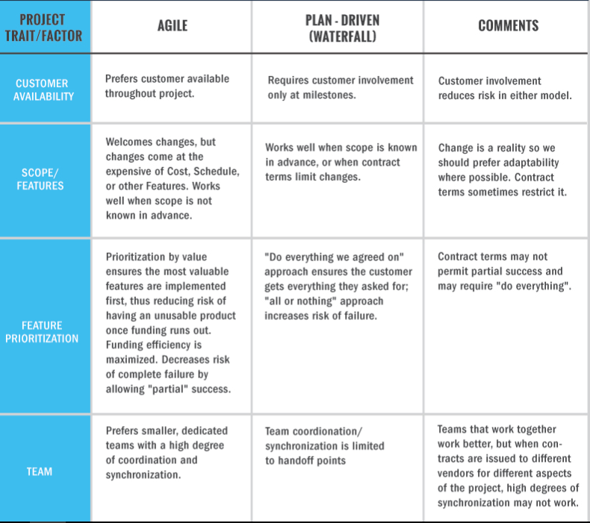
Agile vs. Waterfall: Which one is best for us?

Slide 4
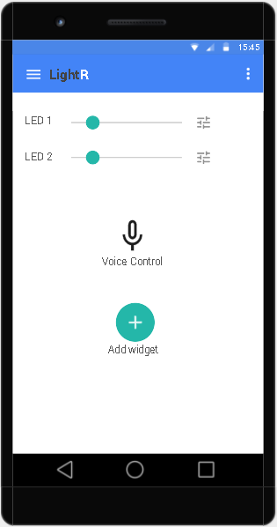
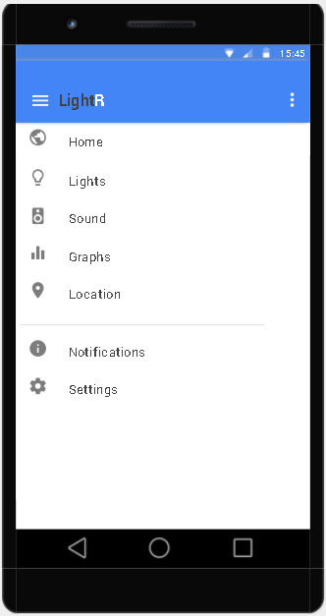
App Prototype/ Potential Design
User opens app and selects sensors to use
Sets preferences e.g. lighting schedule or the standard voice commands
User controls the lights without applying any automated settings
Preferences and settings are saved in the database

Slide 5
Storing the app settings
Storing the settings in the database has several advantages:
Security - users can easily alter settings in the file or overwrite the contents.
For Distribution - the same settings can be updated and loaded onto any machines on the network.
Disadvantages:
Relies on database connection
Overhead when reading from database
Storing in file advantages:
Fast and easy to read and modify.
Disadvantages:
Security issue as mentioned above.
May need encryption on sensitive data.
Versioning is difficult, since you have to create separate files for different versions.
it means that each time we add a platform setting we have to add a column to this table - depending on what database you are using, but you can store the whole settings as XML (SQL server allows this) in the table, so you do not need to alter the table schema every time adding a settings; all you need to do is to modify the XML, adding elements to it or removing from it.

Slide 6
App progress
So far we have only met the hardware requirements but the software has not been designed or implemented
Outlook
Everyone presents their ideas and we merge them together into one concept. Take ideas from every group member to add into the contribution list.
Start developing the app based on the designs presented by the group members.

Slide 7
References
Comparison of methodologies- https://www.seguetech.com/waterfall-vs-agile-methodology/
Philips Hue- http://www2.meethue.com/en-gb
File vs database for storing files- https://stackoverflow.com/questions/1841365/is-it-better-to-store-platform-configuration-in-database-or-a-file

